Slide 1

Implementing Slow Changing Dimensions in a Data Warehouse using Hive and pySpark
Hive Project- Understand the various types of SCDs and implement these slowly changing dimensions in Hadoop Hive and Spark.

Slide 2
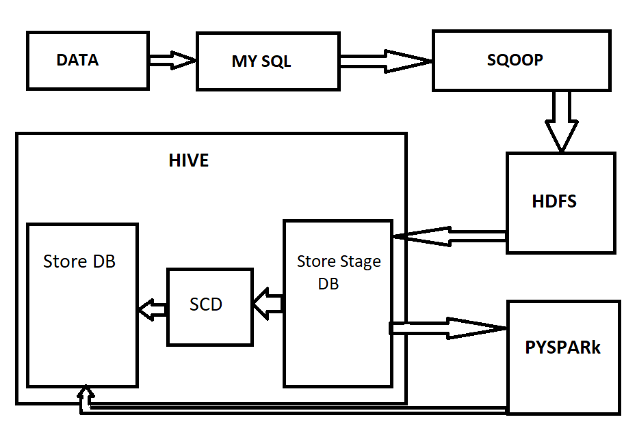
Overview
Customers
Products
Credit Card
Sales Order Header
Sales Order Details

Slide 3
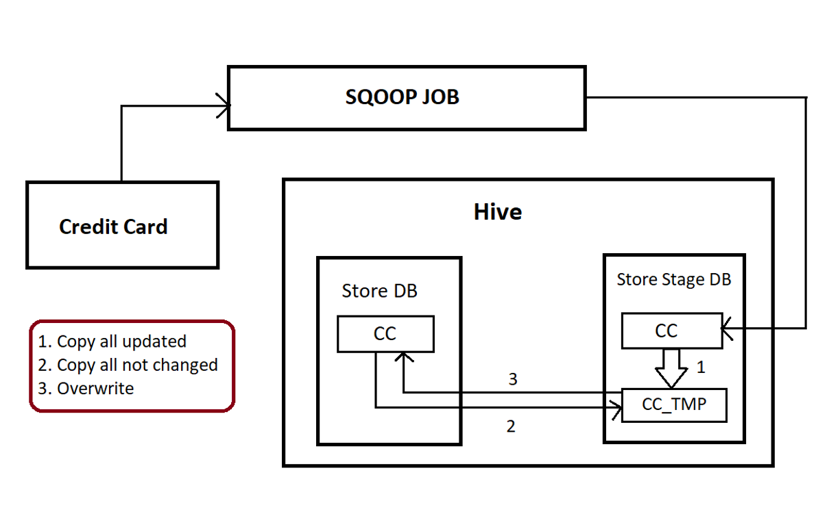
SCD1

Slide 4
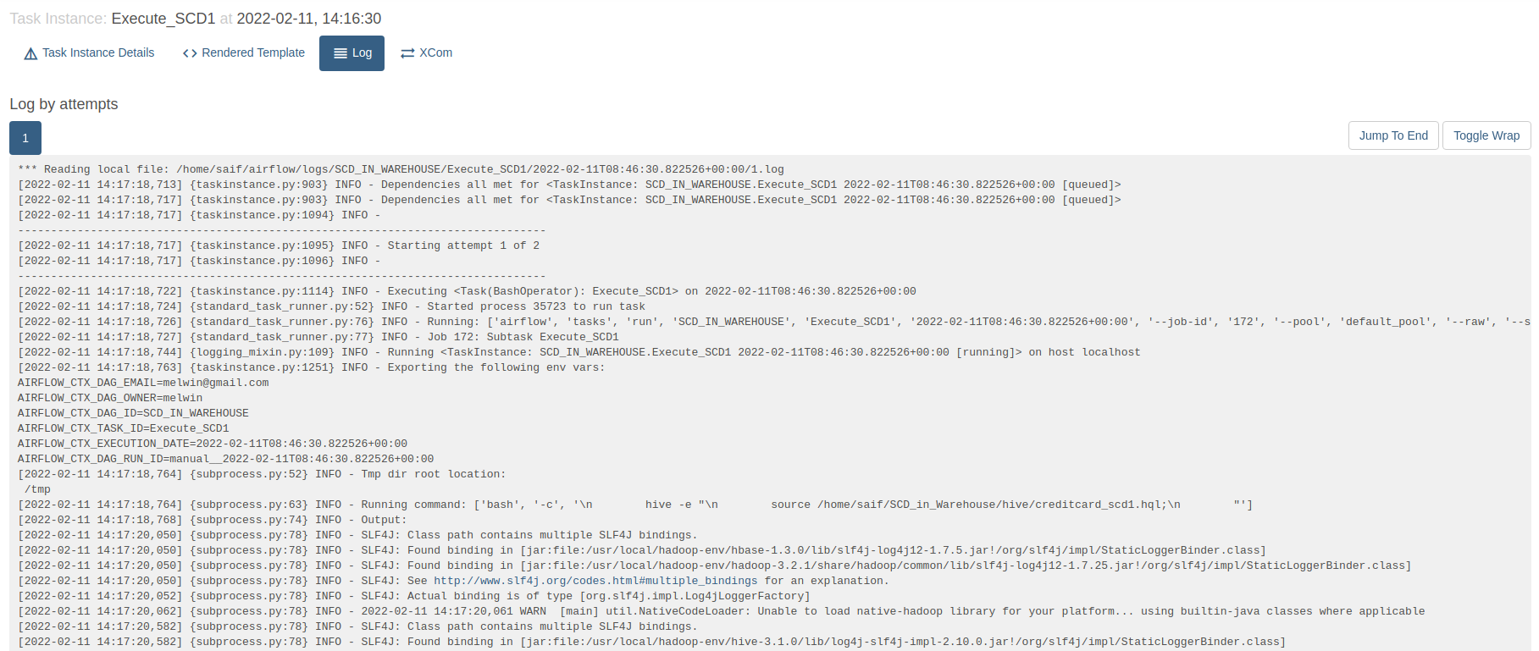
SCD1
Slowly Changing Dimension 1

Slide 5
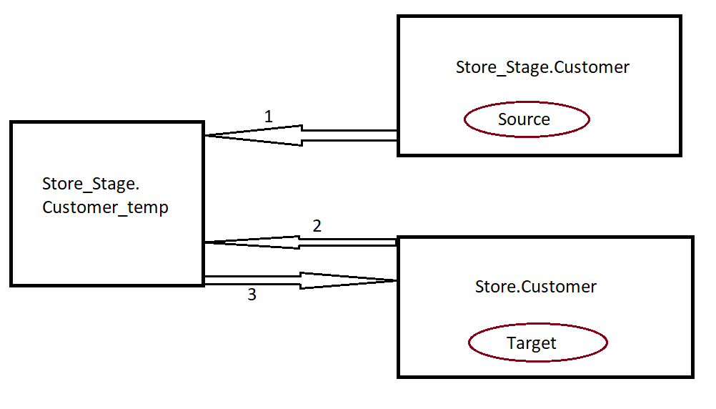
SCD 2
Copy all new record from the source which is not present in the target, copy all updated records from the source to the temp table, copy all not updated records from source to temp ( set all the flag as true)
Copy all records from target (which are updated in the source record) set flag as false, Copy all the record which is not present in the source-target set the flag as true
Finally after step 1 & 2 overwrite the customer_temp to the store.customer(target)

Slide 6

SCD2

Slide 7
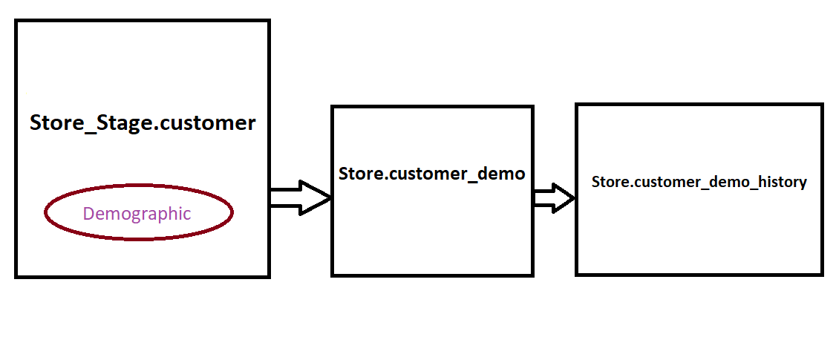
SCD 4
The Type 4 method is usually referred to as using "history tables", where one table keeps the current data, and an additional table is used to keep a record of some or all changes. Both the surrogate keys are referenced in the fact table to enhance query performance.
SCD type 4 - Fast growing dimension
SCD type 4 provides a solution to handle the rapid changes in the dimension tables. The concept lies in creating a junk dimension or a small dimension table with all the possible values of the rapid growing attributes of the dimension.

Slide 8
<IndividualSurvey xmlns="http://schemas.microsoft.com/sqlserver/2004/07/adventure-works/IndividualSurvey">
<TotalPurchaseYTD>8248.99</TotalPurchaseYTD>
<DateFirstPurchase>2001-07-22Z</DateFirstPurchase>
<BirthDate>1966-04-08Z</BirthDate>
<MaritalStatus>M</MaritalStatus>
<YearlyIncome>75001-100000</YearlyIncome>
<Gender>M</Gender>
<TotalChildren>2</TotalChildren>
<NumberChildrenAtHome>0</NumberChildrenAtHome>
<Education>Bachelors </Education>
<Occupation>Professional</Occupation>
<HomeOwnerFlag>1</HomeOwnerFlag>
<NumberCarsOwned>0</NumberCarsOwned>
<CommuteDistance>1-2 Miles</CommuteDistance>
</IndividualSurvey>

Slide 9
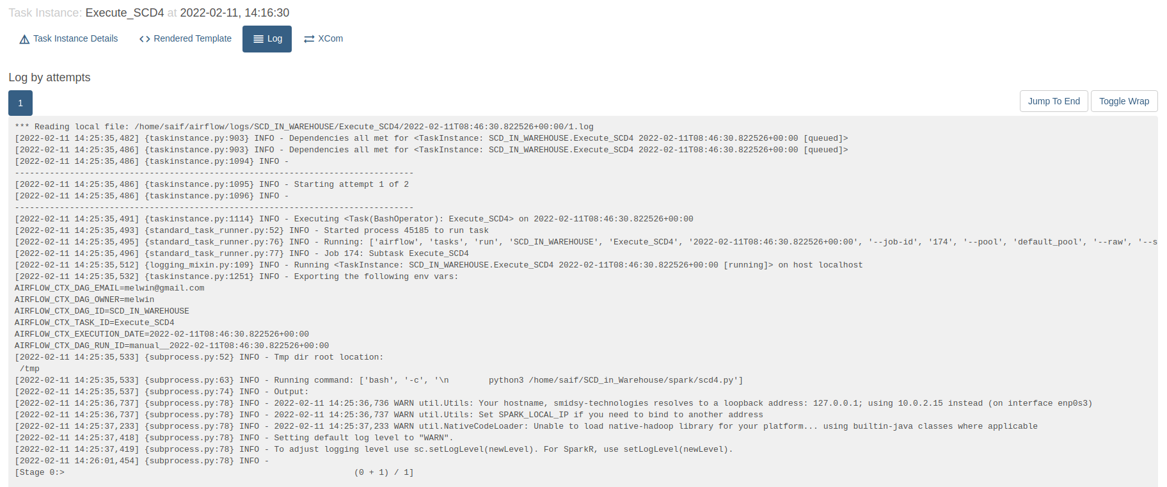
SCD4

Slide 10
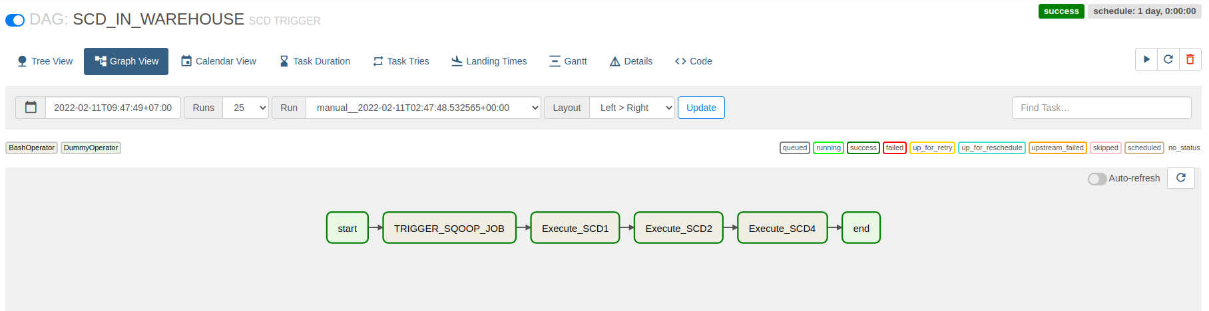

Slide 11
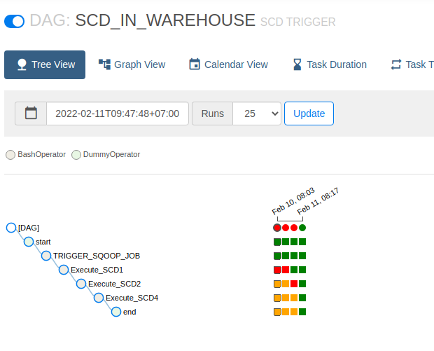
Airflow
(Tree View)

